Slide 1


<Kevin Yang>
<Dec 27th 2023>

Slide 2
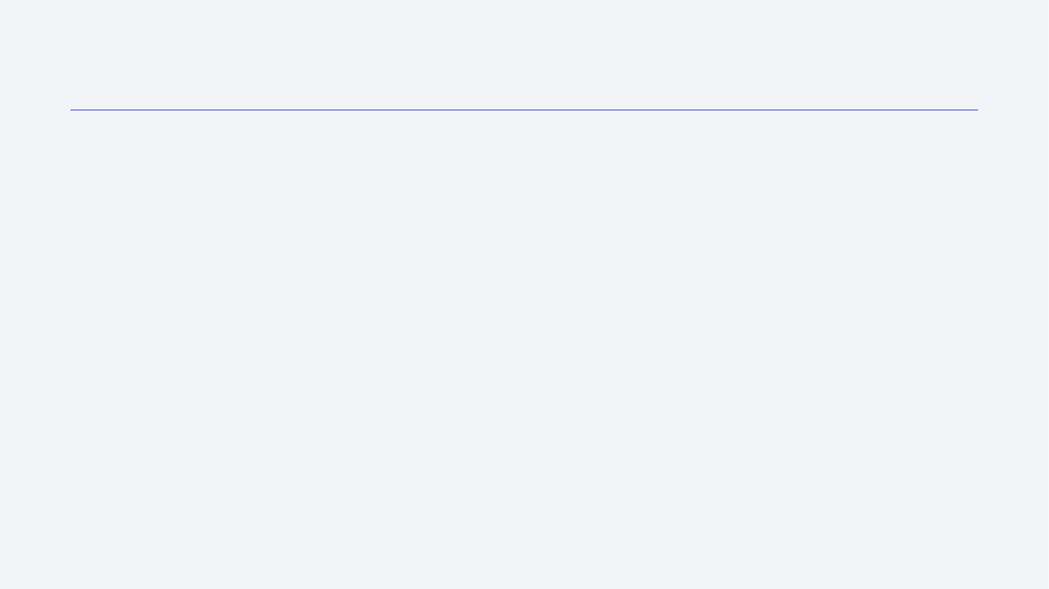
Outline
Executive Summary
Introduction
Methodology
Results
Conclusion
Appendix

Slide 3
Executive Summary
Data was collected from Space X API followed by data wrangling. The was subsequently explored through SQL and visualization. The processed data was used for folium-based visualization on map and also for creating an interactive dashboard. To further help predict successful rate, the features, which includes flight number, payload mass etc were used to train machine learning model for future decision making. The accuracy of the model was further validated by confusion matrix and accuracy scores.
Summary of all results

Slide 4
Introduction
Background
Space X advertises Falcon 9 rocket launches on its website with a cost of 62 million dollars; other providers cost upward of 165 million dollars each, much of the savings is because Space X can reuse the first stage. Therefore if we can determine if the first stage will land, we can determine the cost of a launch. This information can be used if an alternate company wants to bid against space X for a rocket launch.
Objective
The goal of this project is to create a machine learning pipeline to predict if the first stage will land given the data from the preceding labs.

Slide 5

Section 1

Slide 6
Methodology
Executive Summary
Data collection methodology:
Data was collected through requesting to the SpaceX API or scraping records from Wikipedia
Perform data wrangling
Data was subsequently processed: replace null with average, convert integer to floats etc.
Perform exploratory data analysis (EDA) using visualization and SQL
Perform interactive visual analytics using Folium and Plotly Dash
Perform predictive analysis using classification models
Various model were tested and their best parameters were identified through GridSearchCV function on sklearn.

Slide 7
Data Collection
API
Web scraping
Wikipedia page
Space X API
HTML file
Extract the json file
Beautifulsoup
Parsed HTML file
Convert to dataframe
Find ”table” tabs
Tables

Slide 8
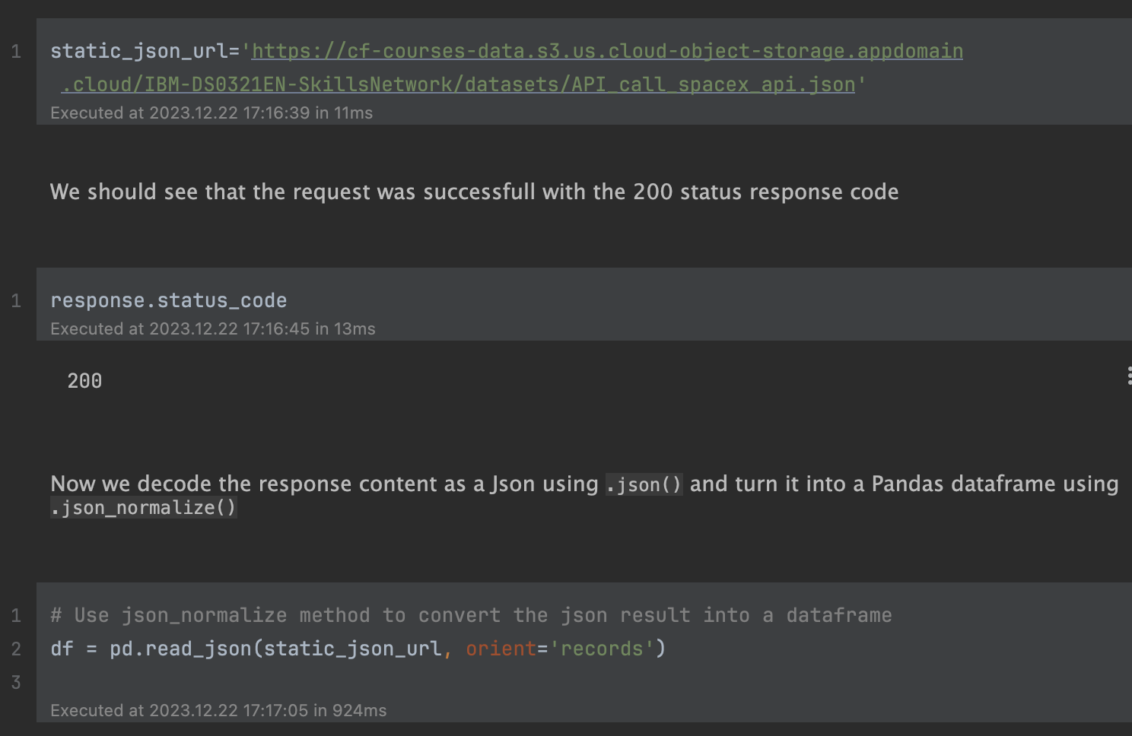
Data Collection – SpaceX API
Full Python codes on Github

Slide 9
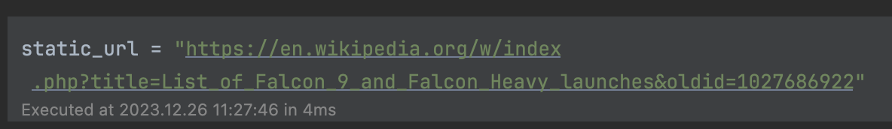
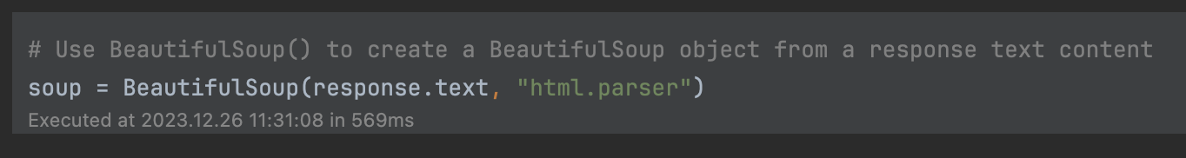
Data Collection - Scraping
Provide URL
Use BeautifulSoup to scrape the Wikipedia article
Full Python code on Github

Slide 10
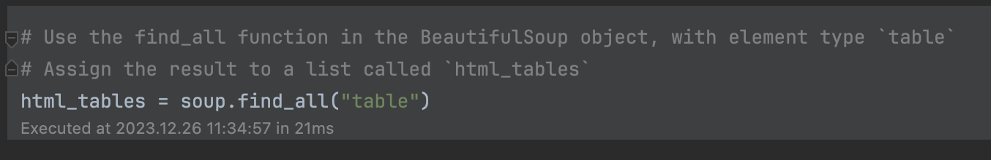
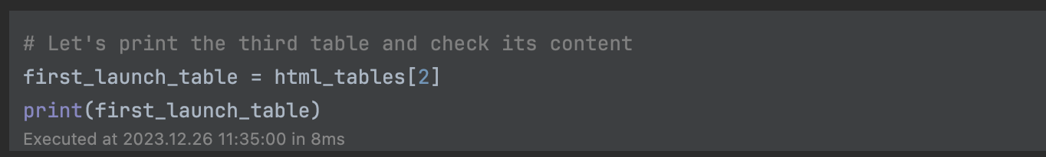
Data Collection - Scraping (continued)
Scrape the table from the Wikipedia article
Trim the collected tables to preserve only those that contains the actual launch records.

Slide 11

Section 2

Slide 12
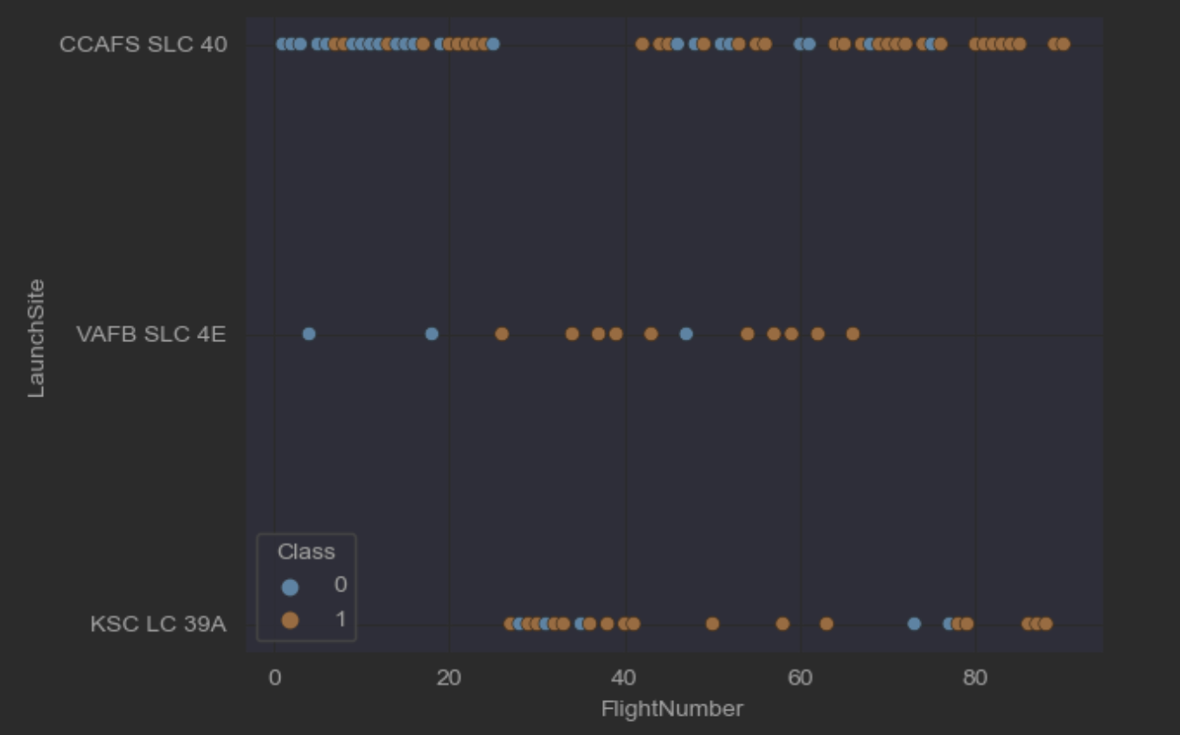
Flight Number vs. Launch Site
Both CCAFS SLC 40 and VAFB SLC 4E launch sites have higher success rates upon increasing the flight number
Full Python code on Github

Slide 13
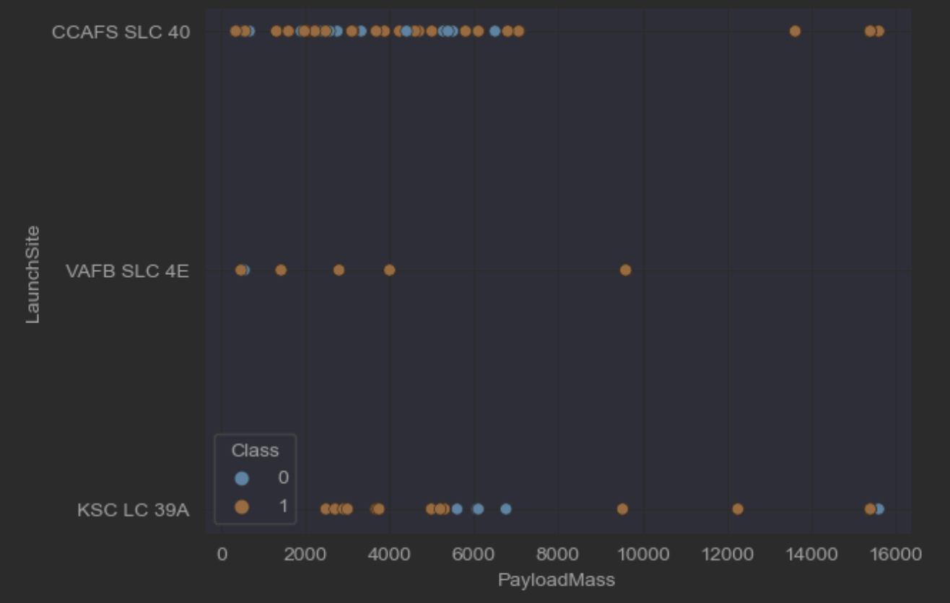
Payload vs. Launch Site
VAFB SLC 4E launch site has no rockets launched for heavy payload mass (> 10,000 Kg)
Full Python code on Github

Slide 14
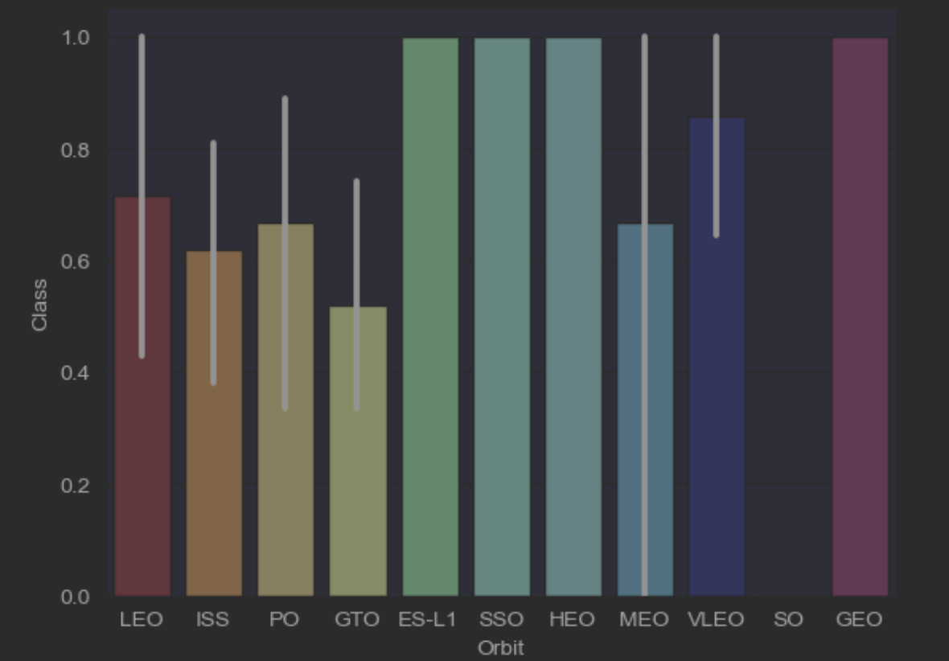
Success Rate vs. Orbit Type
Orbit ES-L1, SSO, HEO, and GEO have higher success rate.
Full Python code on Github

Slide 15
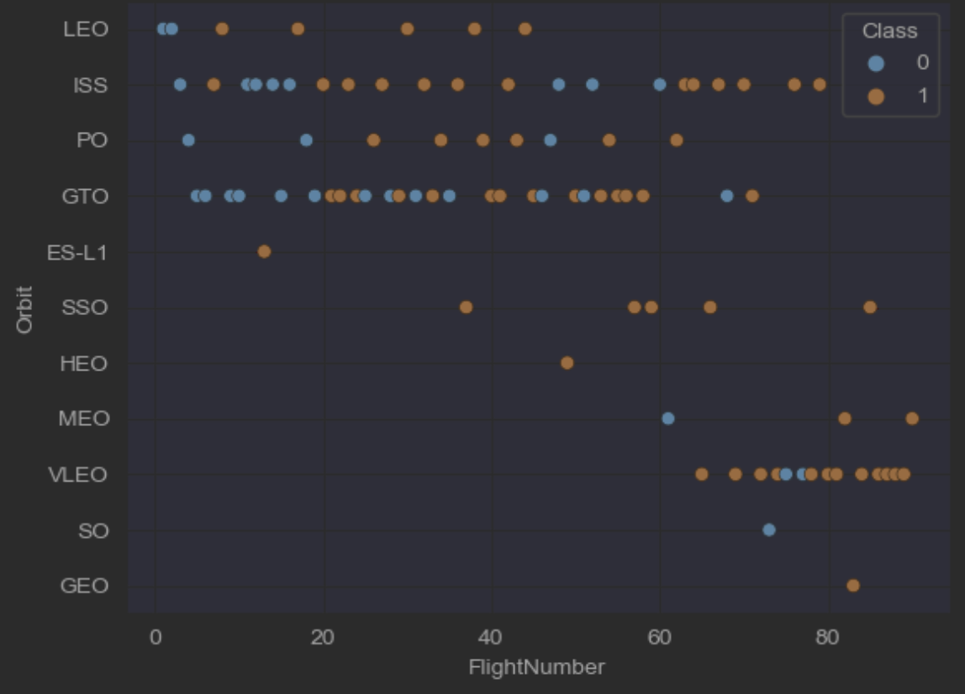
Flight Number vs. Orbit Type
LEO orbit success rate is related to the number of flight.
No relationship between flight number and success rate in GTO orbit.
Full Python code on Github

Slide 16
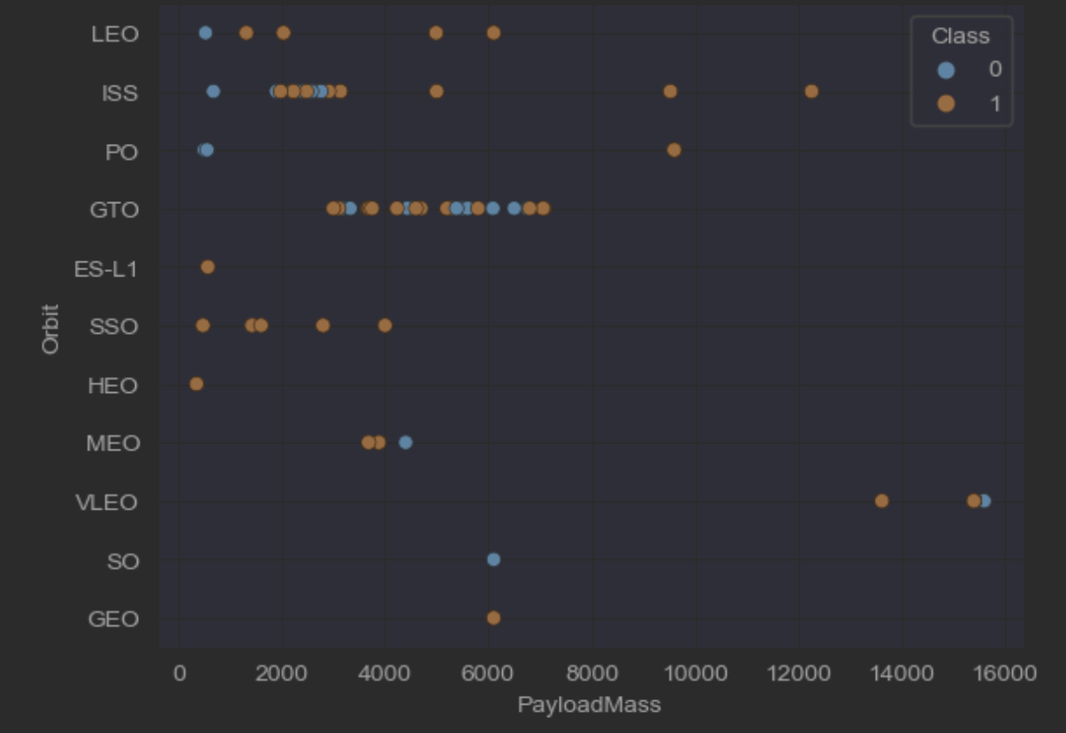
Payload vs. Orbit Type
More successful landing with higher payload mass for orbit Polar (PO), LEO and ISS orbit.
No relationship between payload mass and success rate for orbit GTO.
Full Python code on Github

Slide 17
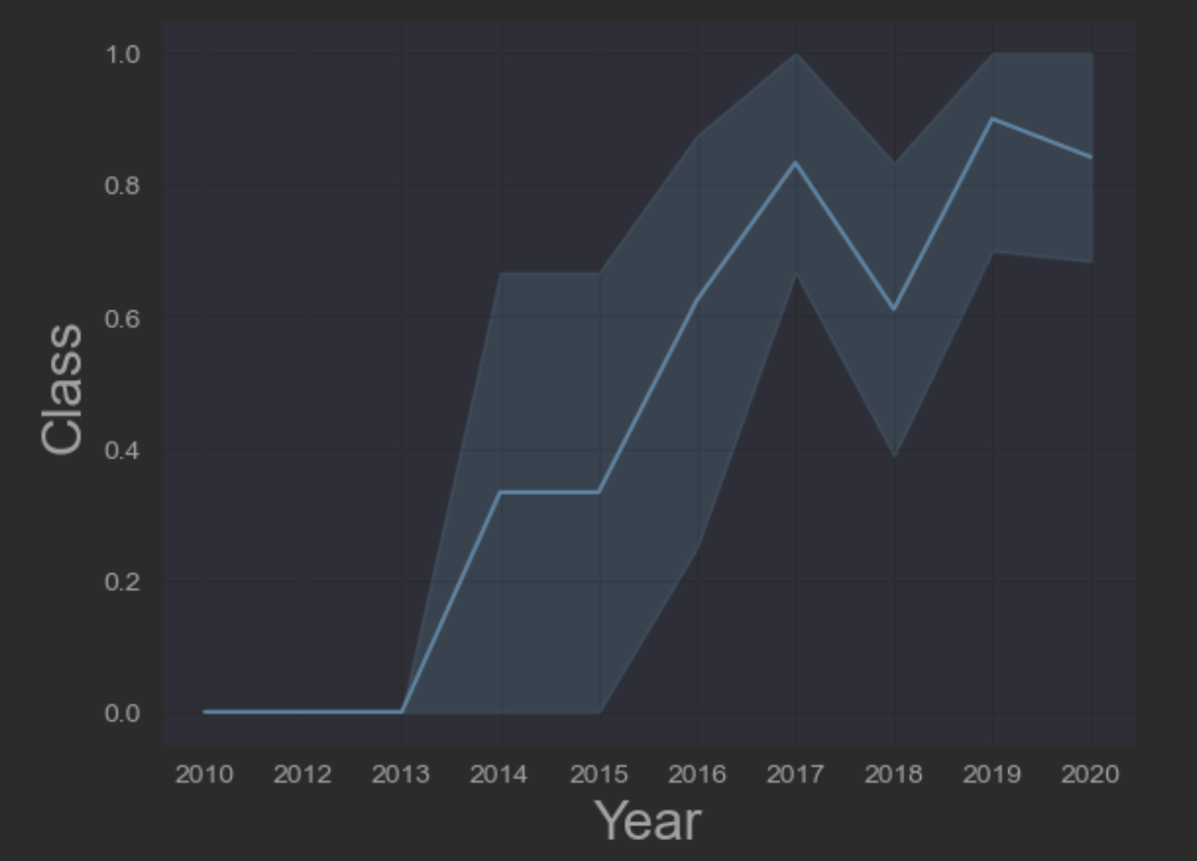
Launch Success Yearly Trend
Success rate sharply increased since 2013 and reached plateau in 2017.
Full Python code on Github

Slide 18
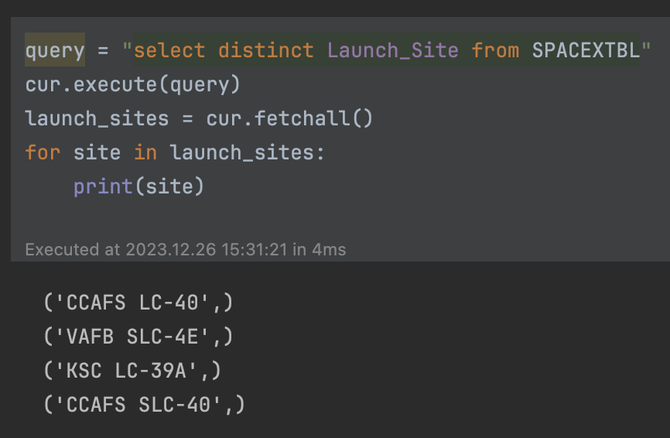
All Launch Site Names
Explore the unique launch sites in the space mission
Four distincted launch sites
Full Python Code on Github

Slide 19
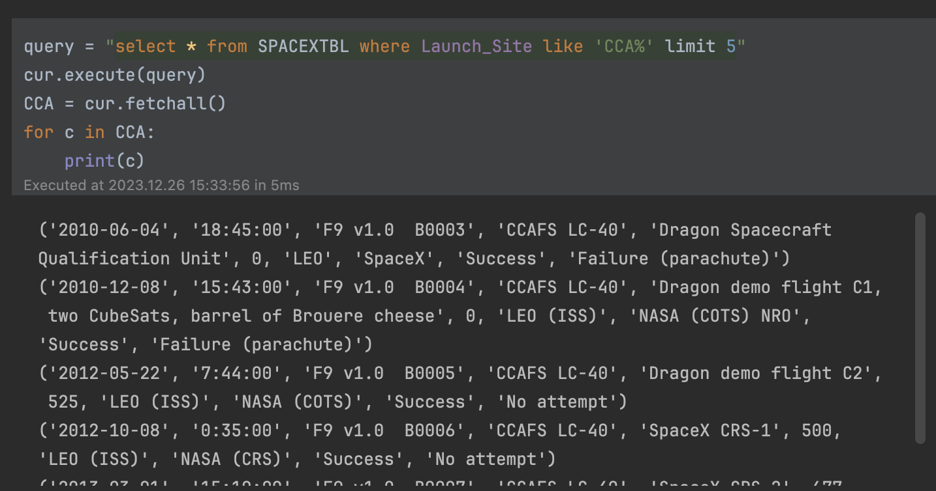
Launch Site Names Begin with 'CCA'
Explore the launch sites begin with the string “CCA” and display the top 5
Full Python Code on Github

Slide 20
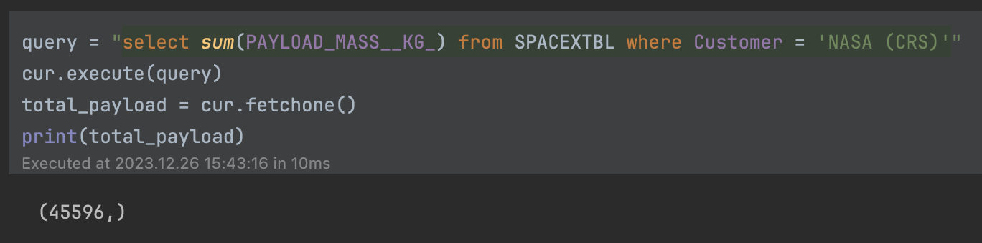
Total Payload Mass
Display the total payload mass carried by boosters launched by NASA (CRS)
Total payload mass is 45,596 Kg
Full Python Code on Github

Slide 21
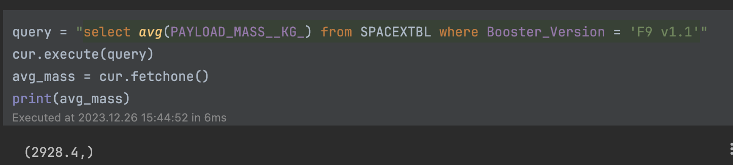
Average Payload Mass by F9 v1.1
Average payload mass carried by booster version F9 v1.1
Averaged payload mass is 2,928 Kg
Full Python Code on Github

Slide 22
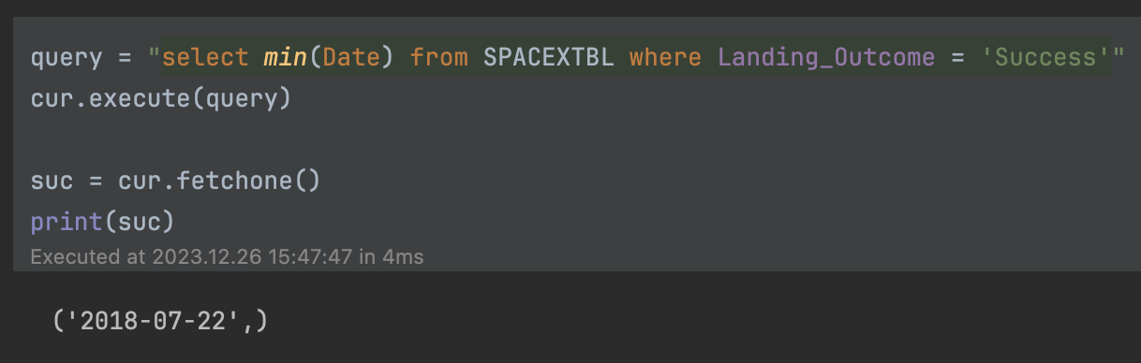
First Successful Ground Landing Date
When was the first successful landing outcome
First successful landing is on 2018-07-22
Full Python Code on Github

Slide 23
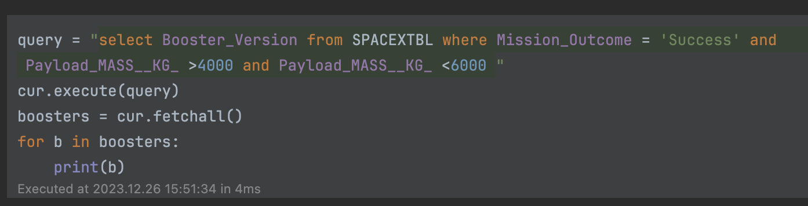
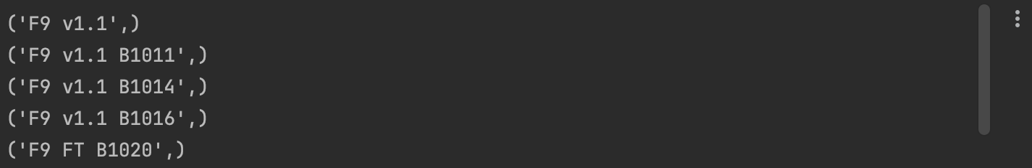
Successful Drone Ship Landing with Payload between 4000 and 6000
Boosters which have success in drone ship and have payload mass between 4000-6000 kg
Full Python Code on Github

Slide 24
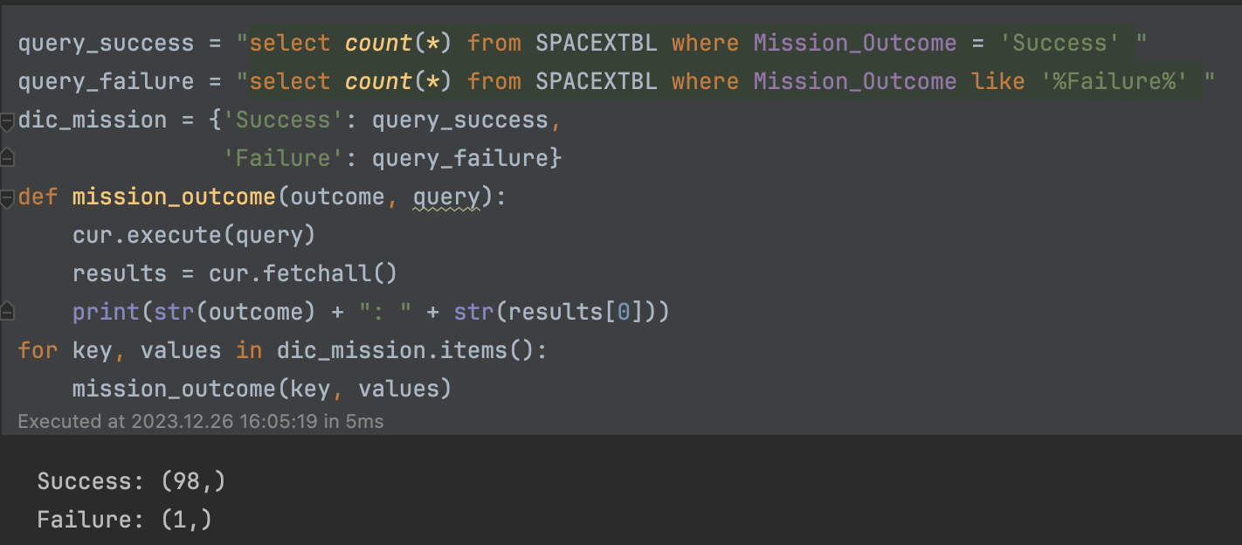
Total Number of Successful and Failure Mission Outcomes
Total number of successful and failure mission outcomes
Full Python Code on Github

Slide 25
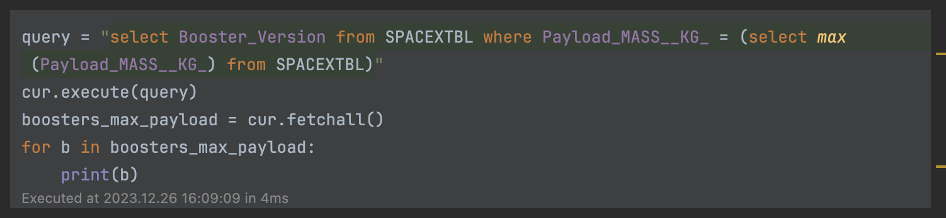
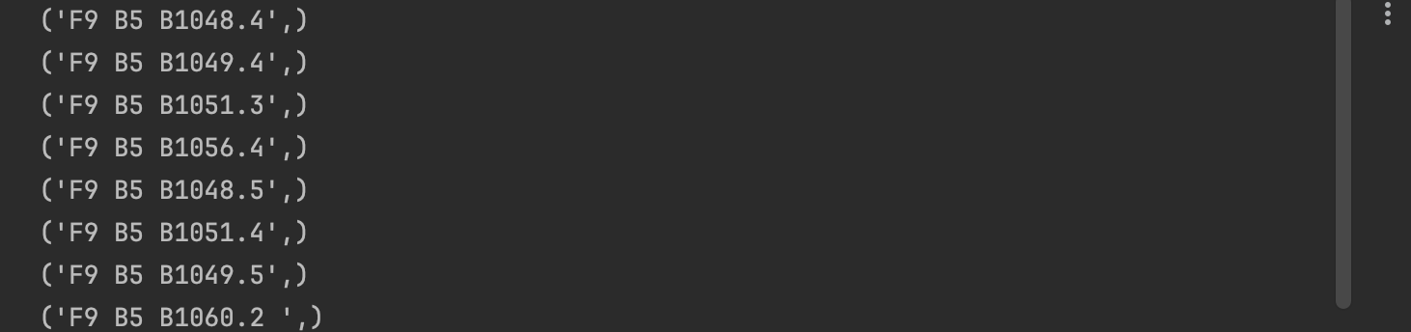
Boosters Carried Maximum Payload
Boosters that have carried the maximum payload mass
Full Python Code on Github

Slide 26
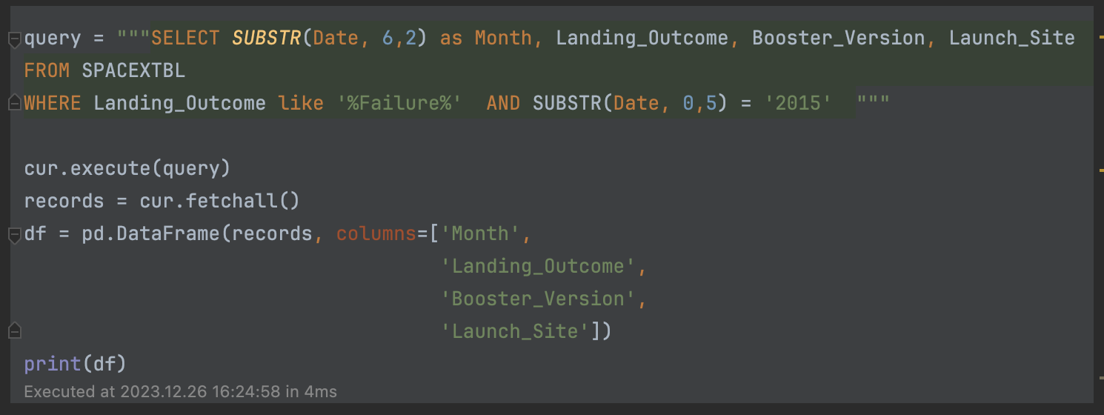
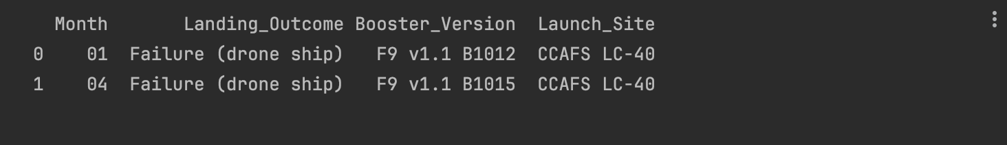
2015 Launch Records
Records of launches for the months in 2015
Full Python Code on Github

Slide 27
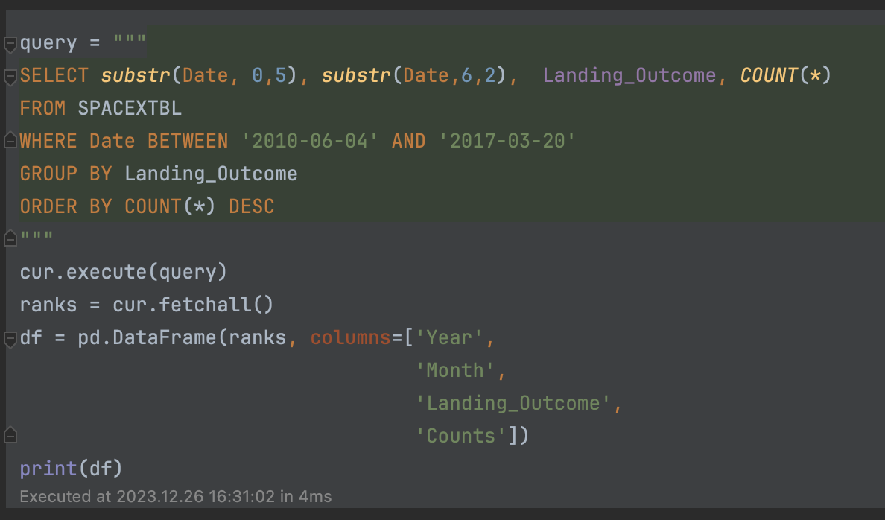
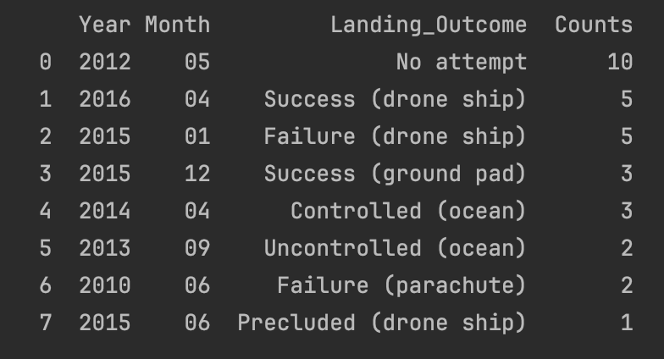
Rank Landing Outcomes Between 2010-06-04 and 2017-03-20
Landing outcomes between 2010-06-04 to 2017-03-20

Slide 28

Section 3

Slide 29
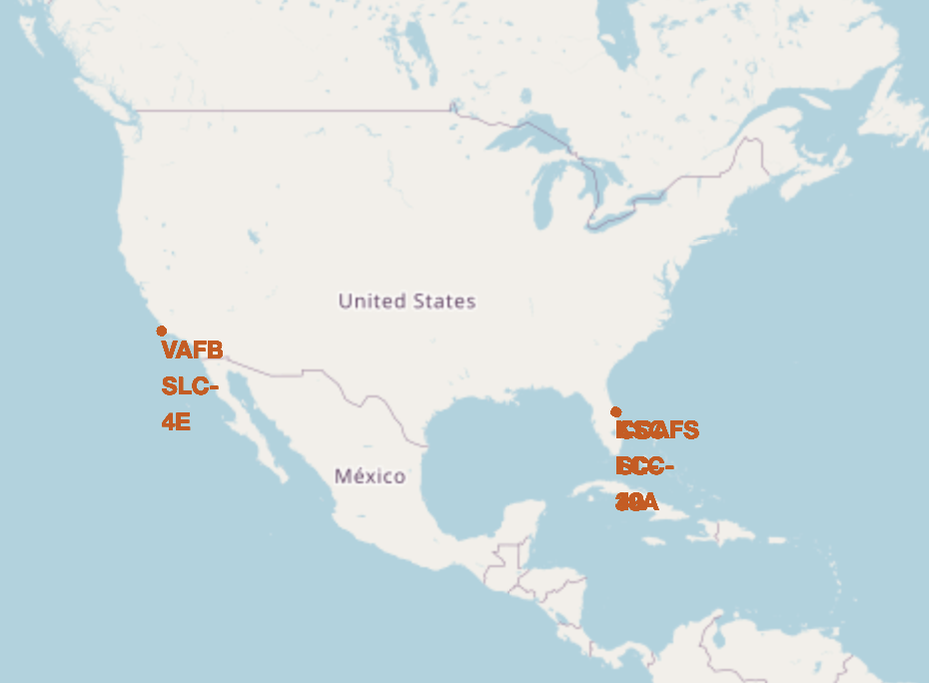
Launch Sites in the US
Total payload mass is 45,596 Kg
Full Python code on Github

Slide 30
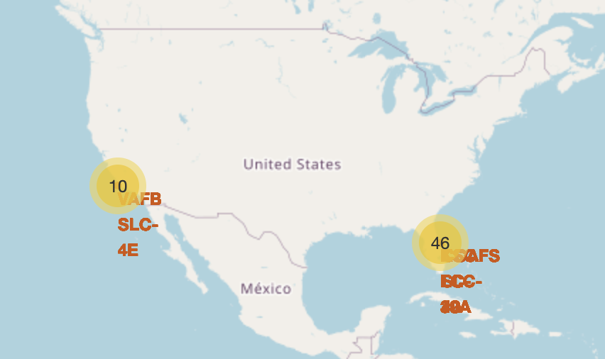
Successful/failed launches for each site
Full Python code on Github

Slide 31

Section 4

Slide 32
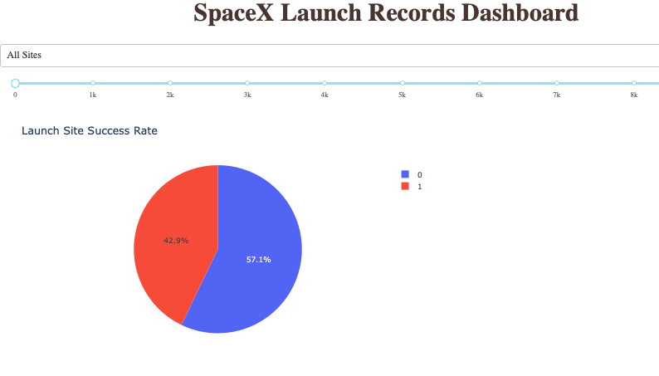
<Dashboard Screenshot 1>
Approximately 43% successful rate for all sites
Full Python code on Github

Slide 33
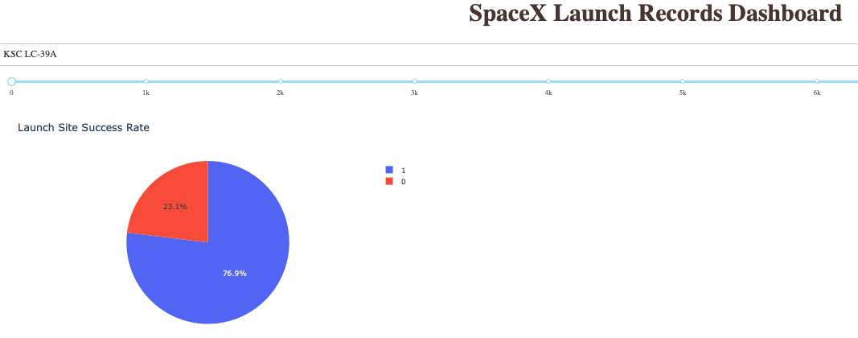
KSCLC-39A site has the highest successful rate
Full Python code on Github

Slide 34
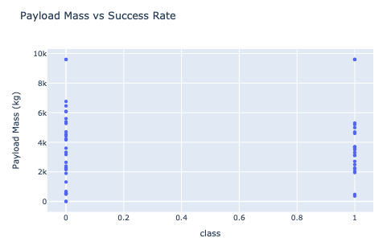
Payload mass vs successful rate for all sites
Successful launch are concentrated within 2000-6000 Kg payload mass
Full Python code on Github

Slide 35

Section 5

Slide 36
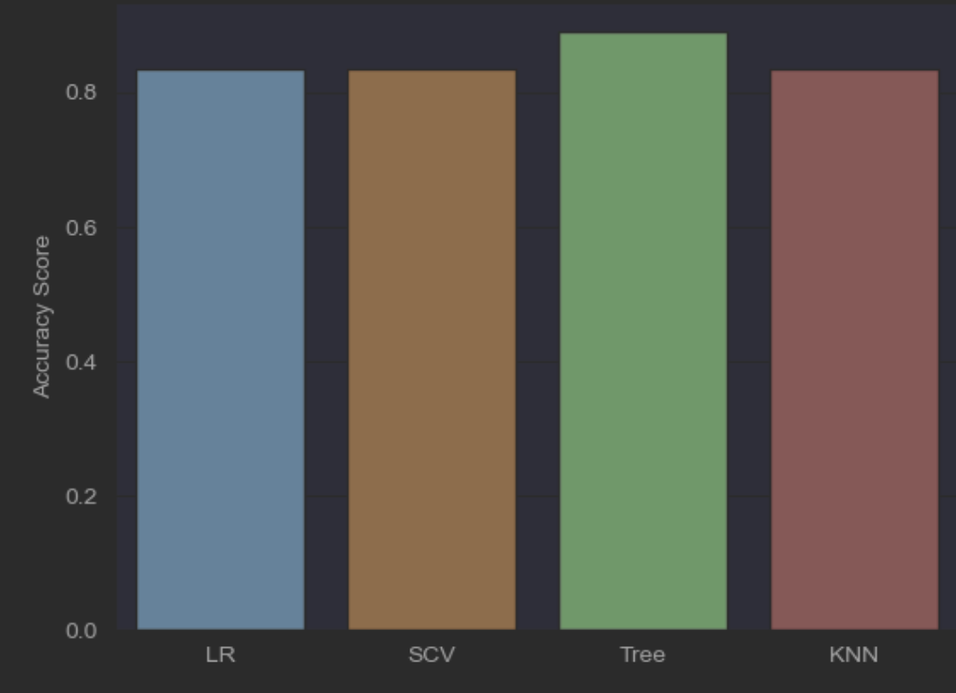
Classification Accuracy
Decision tree has the highest accuracy score.
Full Python code on Github

Slide 37
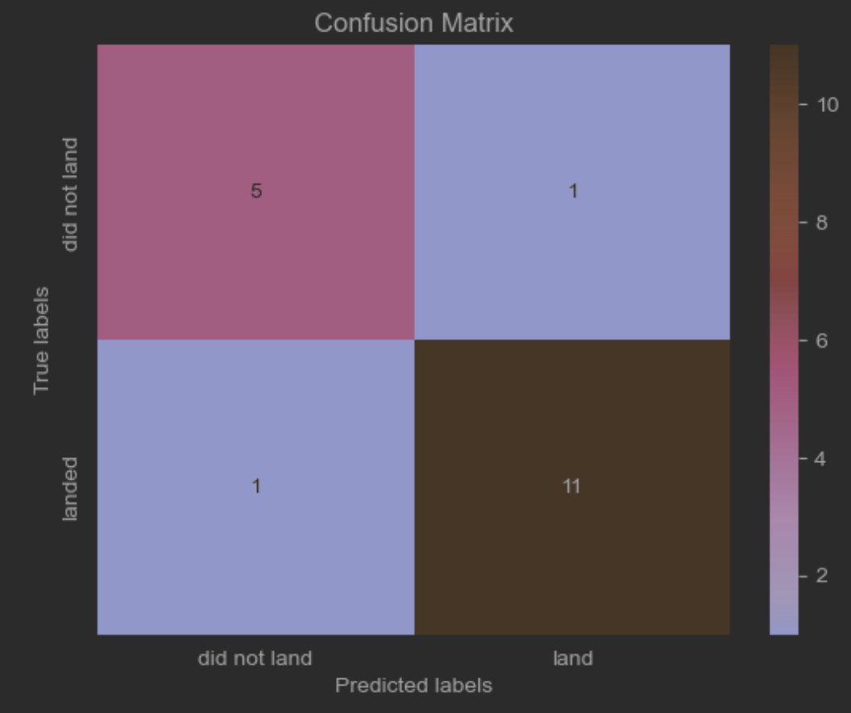
Confusion Matrix
Most of the class are correctly predicted, either the landed or the not landed.
Full Python code on Github

Slide 38
Conclusions
Orbit ES-L1, SSO, HEO, and GEO have higher success rate.
Found feature interactions (e.g., orbit & flight number) in terms of ensuring successful rate.
Success rate sharply increased since 2013 and reached plateau in 2017.
KSCLC-39A site has the highest successful rate
Decision tree can be used to predict successful rate with an accuracy score of 0.89

Slide 39
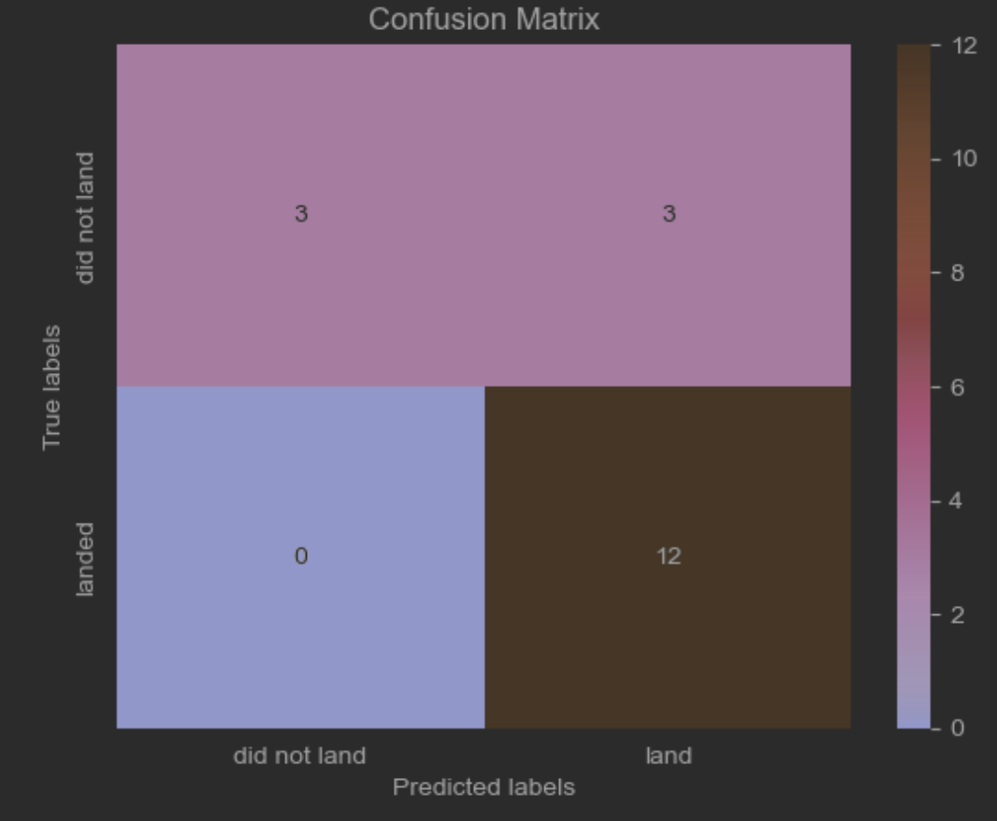
Appendix
Confusion matrix for Logistic Regression model.

Slide 40
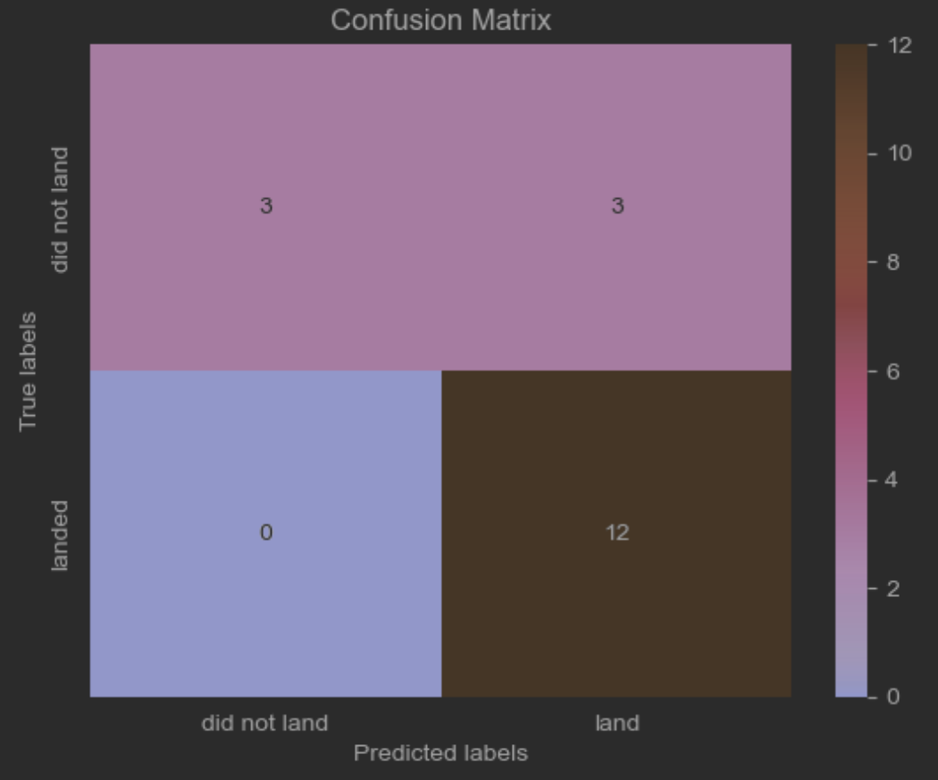
Appendix
Confusion matrix for Support vector machine.

Slide 41
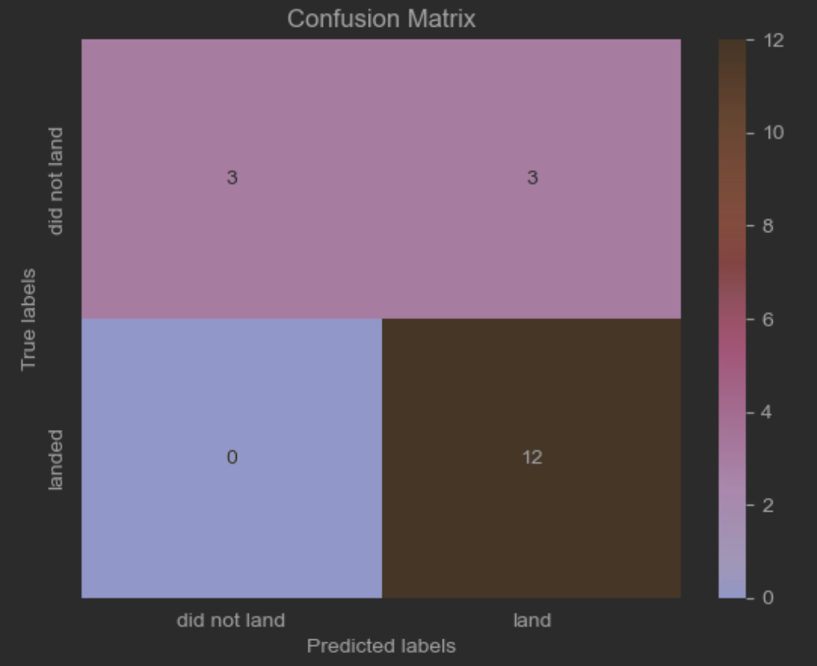
Appendix
Confusion matrix for KNN

Slide 42


